Slide 1


Slide 2
Analytics Process
This activity identifies the data that will support the analytics objectives, from how the data needs to be extracted, cleansed, transformed and handled for analysis, to studying how data points may be related that could inform the final analytics models.
Identify and prioritize data needs and resources
Identify means of data collection and acquisition
Determine how and why to harmonize, rescale, clean and share data
Identify ways of discovering relationships in the data
Determine the documentation and reporting of findings
Use data analysis results to refine business and analytics problem statements
Business Problem Framing
Analytics Problem Framing
Data Requirements
Methodology Selection
Model building
Deployment
Model Lifecycle Management

Slide 3
Introduction to Data Management

Slide 4
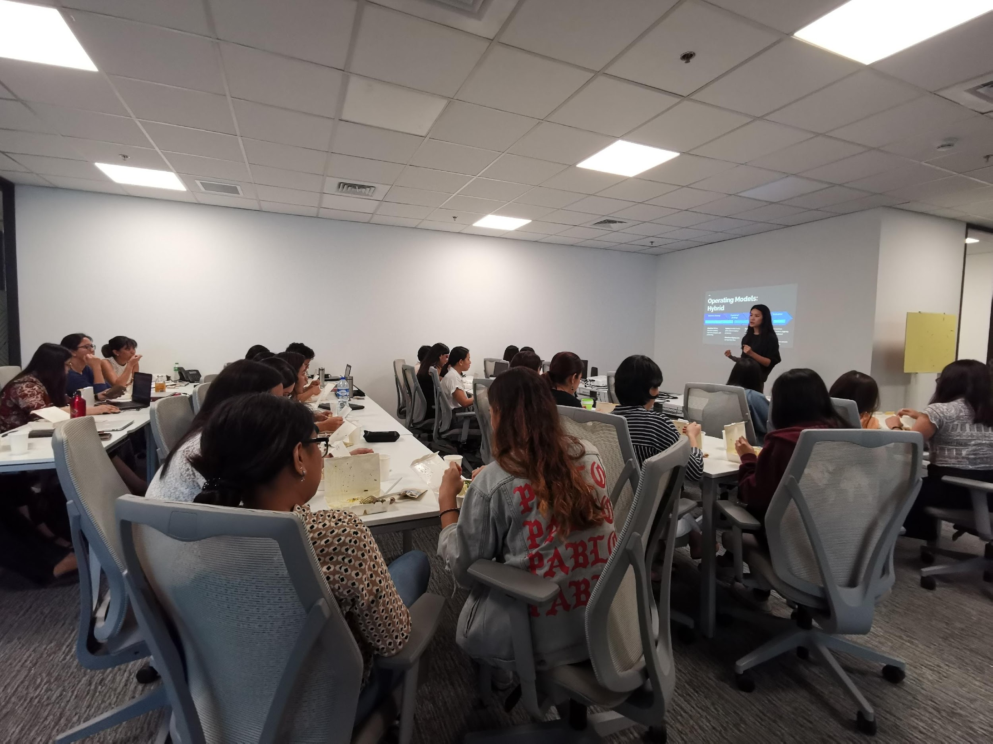

Icebreaker
Which SQL statement is your favorite?
Notes:
Serious: Case - When is very useful in data cleaning
Silly: DISTINCT, because even if you group me with others, I’m always unique

Slide 5
OUTLINE
THEORY
DATA 101
DATA MANAGEMENT
DATA ENGINEERING
Exercise
APPLICATION
Basic IO
Advanced IO
Exercise

Slide 6
DATA 101

Slide 7
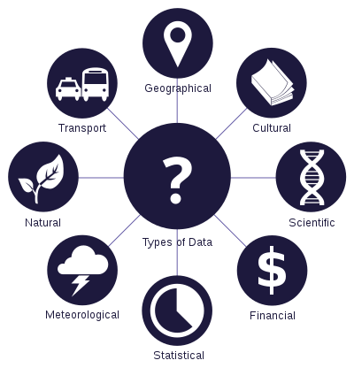
DATA 101
What is Data?
Originally, data is plural for “datum”, a Latin word
Datums are most often called “data points”
Data represents a collection of data points (also called datasets)
Can be used as both singular and plural form
Data are characteristics or information, usually numerical, that are collected through observation.
- Wikipedia

Slide 8
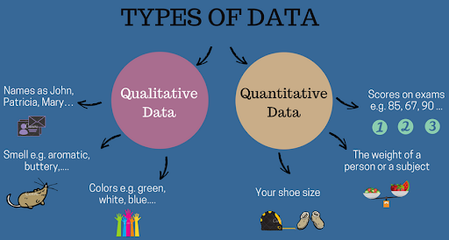
DATA 101
Types of Data
Quantitative – Numbers, tests, counting, measuring ( still confused? Ask -- can it be counted?)
Qualitative – Words, images, observations, sounds, videos, conversations, etc.

Slide 9



DATA 101
Structured & Unstructured
Tables, Text, Images
Small to Big
Surveys, purchases, genes
1 2.0
F, M
Numerical & Nominal
Integers, numbers, categories, orders
Public & Private
Academic, open-data, commercial, personal
Notes:
Orders - small, regular, large, XL

Slide 10
DATA 101
01
Master Data
People, Places, & Things
Customer Data, Supplier Data
02
Transactional Data
Internal or External Business Event
Sales Data, Payment Data
03
Reference Data
For use with Categorization of business data
Jurisdictions, Currencies
04
Metadata
Describes other data for ease of interpretation or use
Audit Trail, Date of creation
05
Unstructured Data
Data lacking a consistent format or syntax to describe objects and attributes
Social Media, Video, Images, Audio
Different Categories of Data
Notes:
Orders - small, regular, large, XL

Slide 11
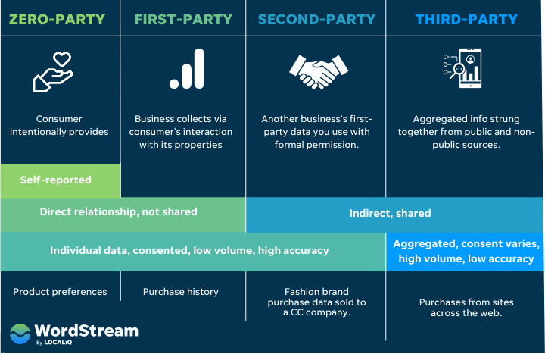
DATA 101
Different Categories of Data

Slide 12

DATA 101
Financials
Demographics
Text, Images, Audio, Video
What others can you think of?
Clicks
Scientific Data
Different Categories of Data

Slide 13


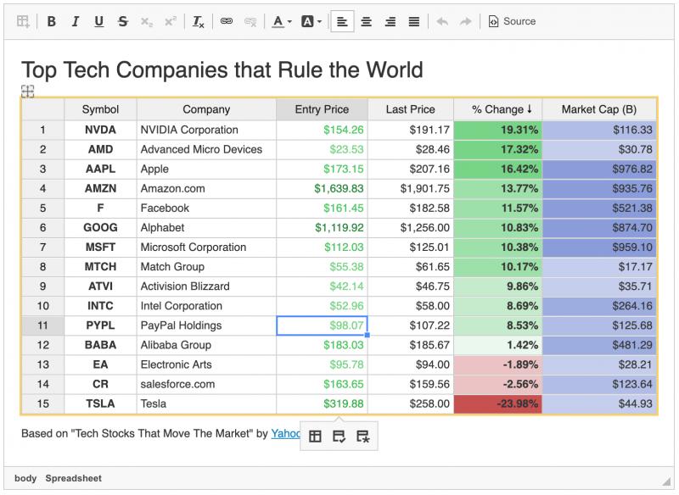
DATA 101
Spreadsheets are one starting point
Databases allow for more flexibility and size
Data lakes allow for max flexibility and size
https://ckeditor.com/cke4/addon/spreadsheet
https://www.mysqltutorial.org/mysql-sample-database.aspx
Notes:
Allow for co-teacher to elaborate:
How data magnitude affects projects
How big data can still be messy (or even messier)
How to progress from spreadsheets to databases and even larger

Slide 14
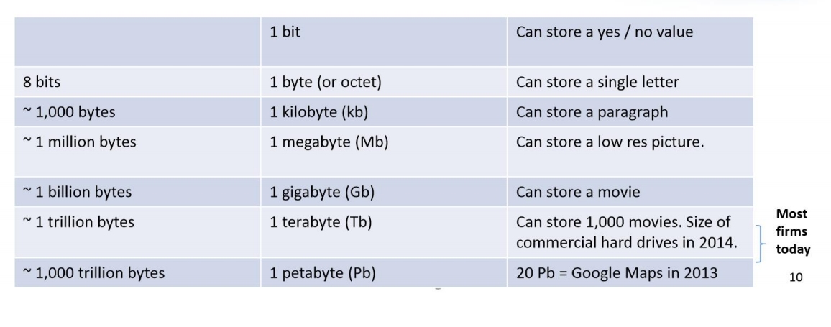
DATA 101
Understanding Sizes
The size can give an idea of amount of data that can be processed as well as potential challenges it might give
Dataset size is expressed in data points ie. Lines, rows and/ or columns depending on the structure of the data you are analyzing
Size can also be expressed in terms of storage consumption

Slide 15
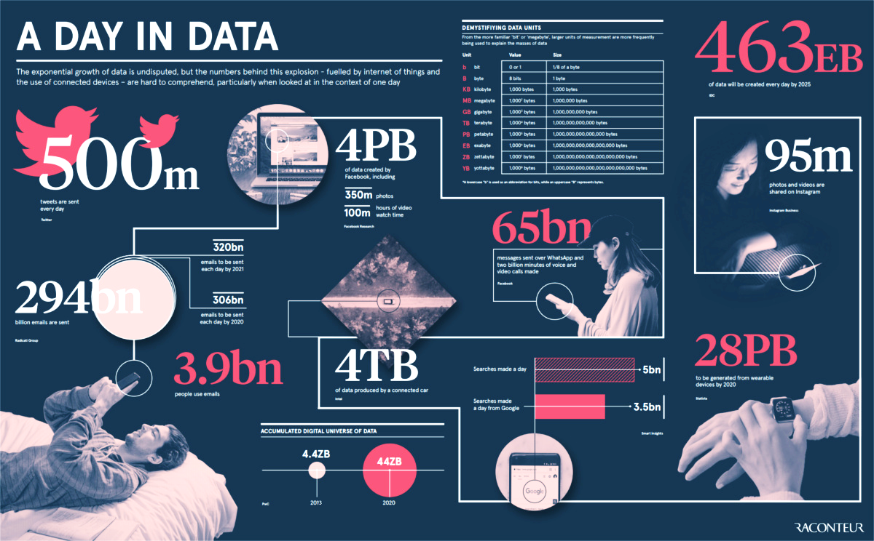
DATA 101
Published 4 years ago on April 15, 2019
https://www.visualcapitalist.com/how-much-data-is-generated-each-day/
Notes:
Data is significantly larger than the apps that spawned them

Slide 16
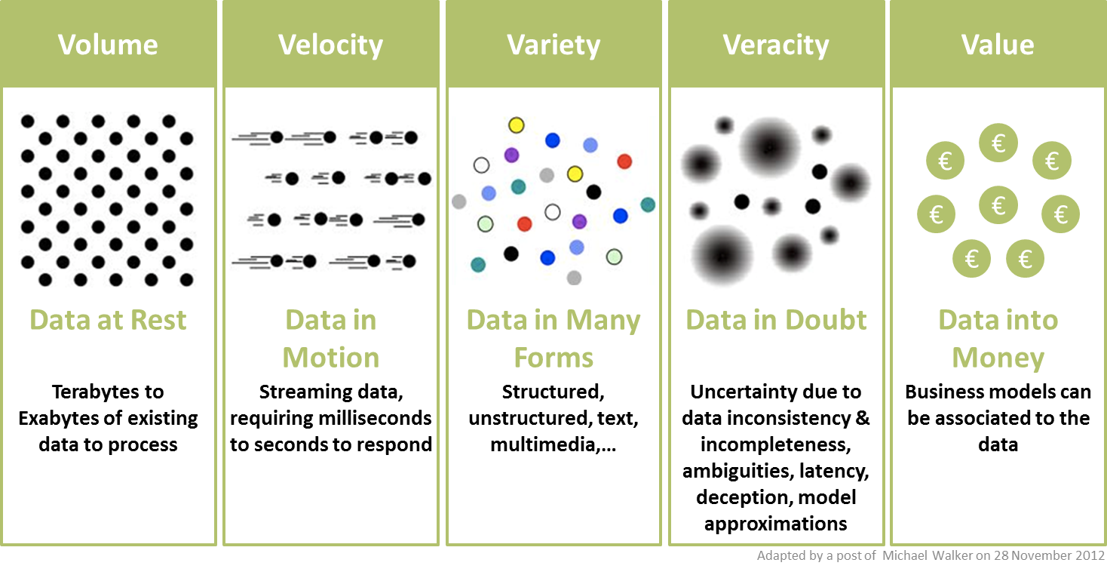
DATA 101
Properties of Data
Notes:
Data is significantly larger than the apps that spawned them

Slide 17
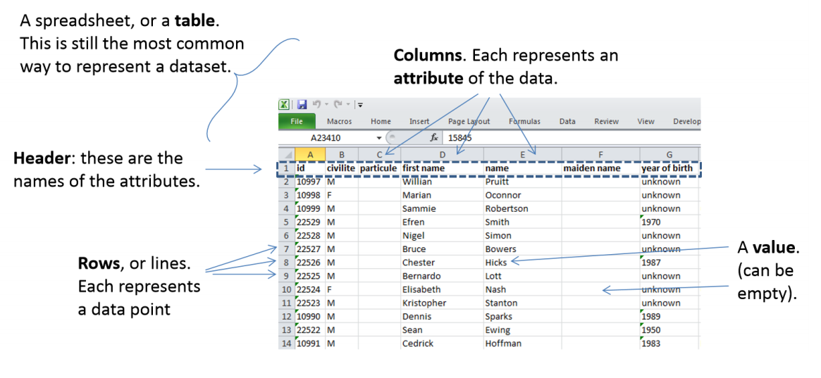
DATA 101
Example: People Data stored in Excel tables

Slide 18
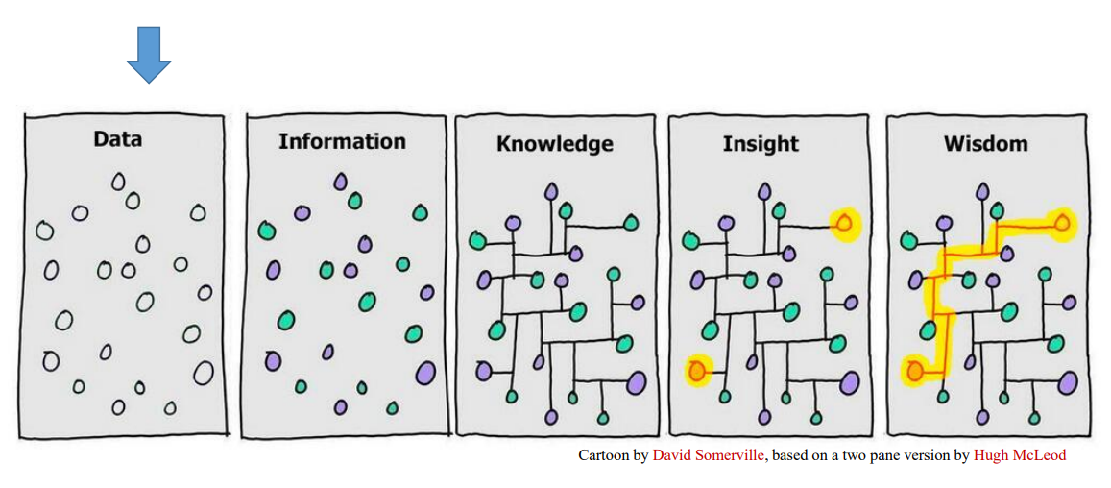
DATA 101
Data Increases in Value →

Slide 19
DATA MANAGEMENT

Slide 20

Data Management comprises all disciplines related to managing data as a valuable resource.
Close your eyes and imagine this young fragile plant is our DATA.
What do we need to do to manage and take care of it?
- Plantita / Plantito data scientists, probably

Slide 21
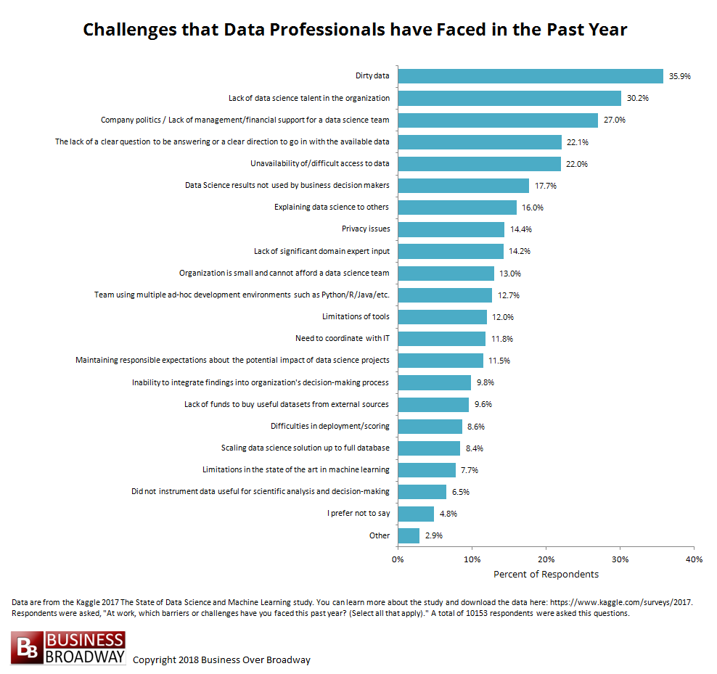
DATA MANAGEMENT

Slide 22
DATA MANAGEMENT
The Data Lifecycle
Generation / Collection
Data is “born” and need to be collected and stored
Use
Processed data / information / knowledge is accessed by end user applications
Cleansing / Preparation
Once gathered, data needs to be “prepared” for use
Analysis / Processing
Data is transformed for use towards specific business problems
Sharing
Data is shared to users for reporting, analysis, or further collection

Slide 23
BUZZWORD
Data is the new oil?
What do you think?

Slide 24
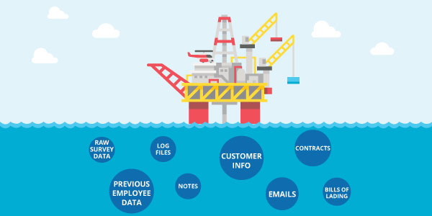
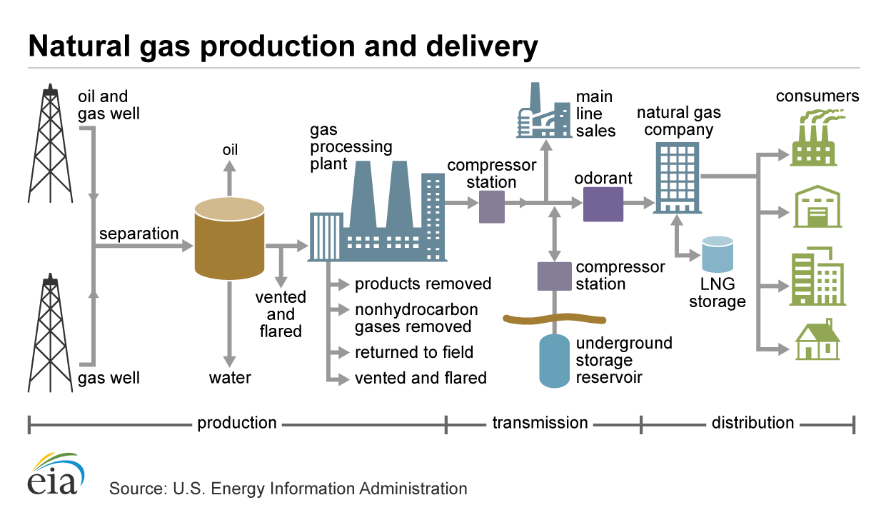
DATA MANAGEMENT
BIG PICTURE
Upstream
Downstream
Find the data
Collect the data
Clean the data
Store the data
Process the data
Serve data
Govern the data
Analyze the data

Slide 25
Upstream Journey
Upstream
Find the data
Collect the data
Clean the data
Store the data

Slide 26
DATA MANAGEMENT
First ask the question, what data do we need / “might have” and does it actually exist?
People
Products
Location
Activities

Slide 27
DATA MANAGEMENT
If the data exists, where is it generated / captured so we can collect them?
Traditional
Observations
Tests
Surveys
Documents
Corporate
Point of Sale
Inventory Systems
HR systems
Internet Proxy
How are they collected?
Analog VS Digital
Offline VS Offline
One time VS Batch VS Realtime
Edge Sensors
Weather balloons
ID scanners
CCTV cameras
Home internet routers
BONUS: External Data
Government Websites
Yellow Pages
Twitter
Data sellers ie. Nielsen

Slide 28
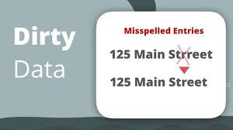
DATA MANAGEMENT
How do we know if our data is dirty?
How do we make a plan to clean it?
Duplicate Data
Outdated Data
Insecure Data
Incomplete Data
Inaccurate / Incorrect Data (source vs rule)
Inconsistent Data
Excessive Data*
Manual Data 🡪 Digital Data
Fix in storage VS Fix at source

Slide 29
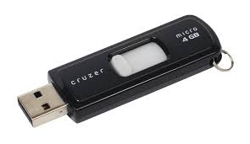
DATA MANAGEMENT
Where and how do we store our data?
Location
Local
On prem Server
Cloud
Format
Flat Files ie. CSV, Excel
Binary
Database
Retention
How long do we keep the data?
How much do we keep?
How recent do we refresh it?
Security
Who can access the data?
Is the data encrypted?
Is there a backup strategy?

Slide 30
Downstream Journey
Downstream
Process the data
Serve data
Govern the data
Analyze the data

Slide 31
DATA MANAGEMENT
Once we have it – What do we need to “change/transform” the data to make it usable?
Add
Enrichment via Joining of other data
Derivation of calculated values
Business rules
Change
Translation ie. 1 to Female
Remapping of variables
Splitting of variables
Aggregation
Removal/ Filtering
Dropping of invalid data
Deletion of unneeded columns
Removal of duplicates

Slide 32
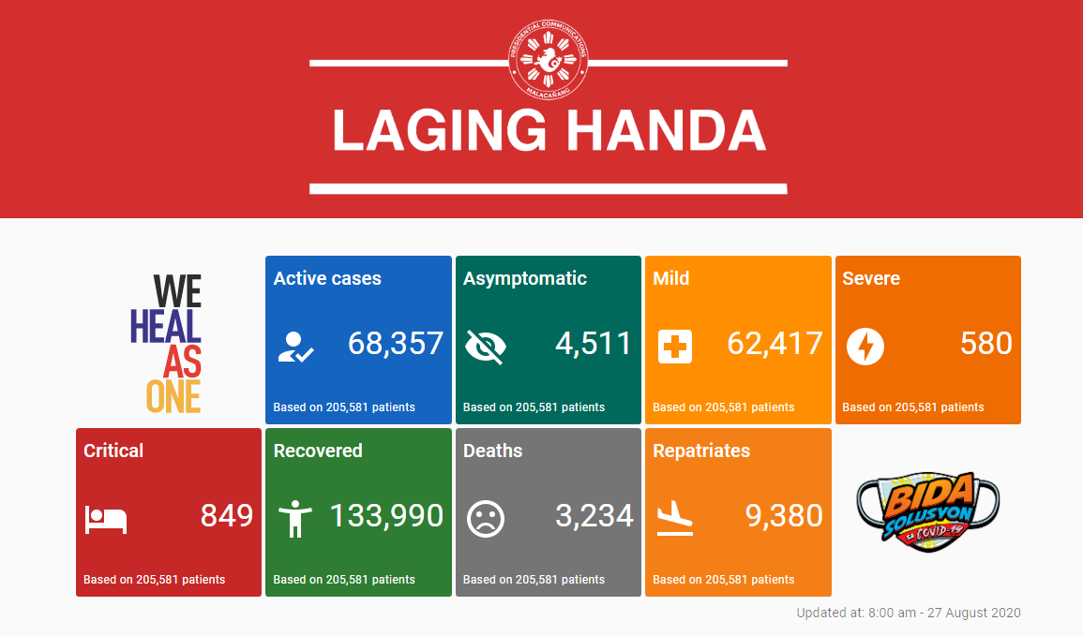
DATA MANAGEMENT
How do we share the data so people can use it?
Centralized Internal Database
Secure API over Internet
Restricted network drives
Password protected files
Business Intelligence / Reporting
Dashboards
Archiving
Legal

Slide 33

DATA MANAGEMENT
Taking care & governing our data
Data Quality
Data Model & Architecture
Metadata / Data Dictionary
Ownership, Access and Security
Transparency & Accountability
Retention and Backup

Slide 34
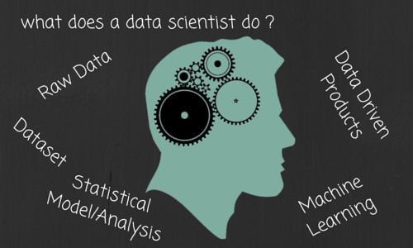
DATA MANAGEMENT
Data Consumption for Analytics
This is where YOU come in!
What tools can we use on the data? Ie. Excel, python, SQL, Tableau, and similar ones like R, java, PowerBI, SAS, etc
What new insights / knowledge can we generate / explore out of the data?
Can these new insights / knowledge be used to create new value or address existing business problems?

Slide 35
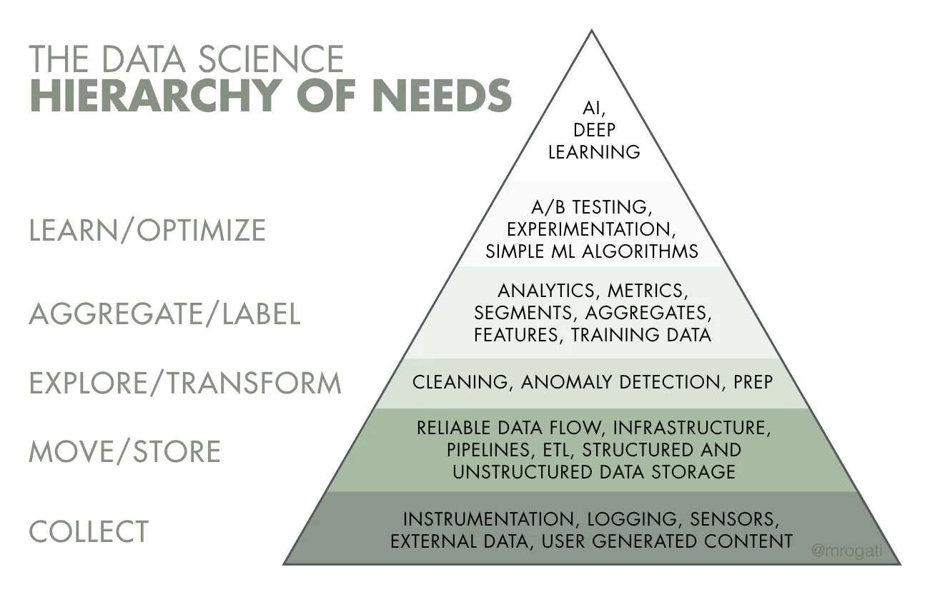
DATA MANAGEMENT
Knowledge
actionable, impactful, sustainable
Information
summarized, visualized, retroactive
DATA
Raw, potential
*Warning: Not all companies have a well established Data Management & Engineering Function
https://hackernoon.com/the-ai-hierarchy-of-needs-18f111fcc007
Notes:
Data management is managing the foundations (first two)
The pyramid also shows how much time and resources are needed to support all the activities on top
For an org that is just starting their data journey, you will spend the first year managing the bottom activities – with a small win at the top.

Slide 36
DATA MANAGEMENT
SQL is the language across many industry platforms, with each having their own ‘dialect’ and special features.
DQL (Query)
SELECT
FROM
GROUP BY
DDL (Definition)
CREATE
ALTER
DROP
DML (Manipulate)
INSERT
UPDATE
DELETE
DCL (Control)
GRANT
REVOKE
Notes:
Where does SQL come in? All parts in the pipeline uses it.
DDL – Data Definition Language
DQL – Data Query Language
DML – Data Manipulation Language
DCL – Data Control Language
TCL – Transaction Control Language
https://www.geeksforgeeks.org/sql-ddl-dql-dml-dcl-tcl-commands/

Slide 37
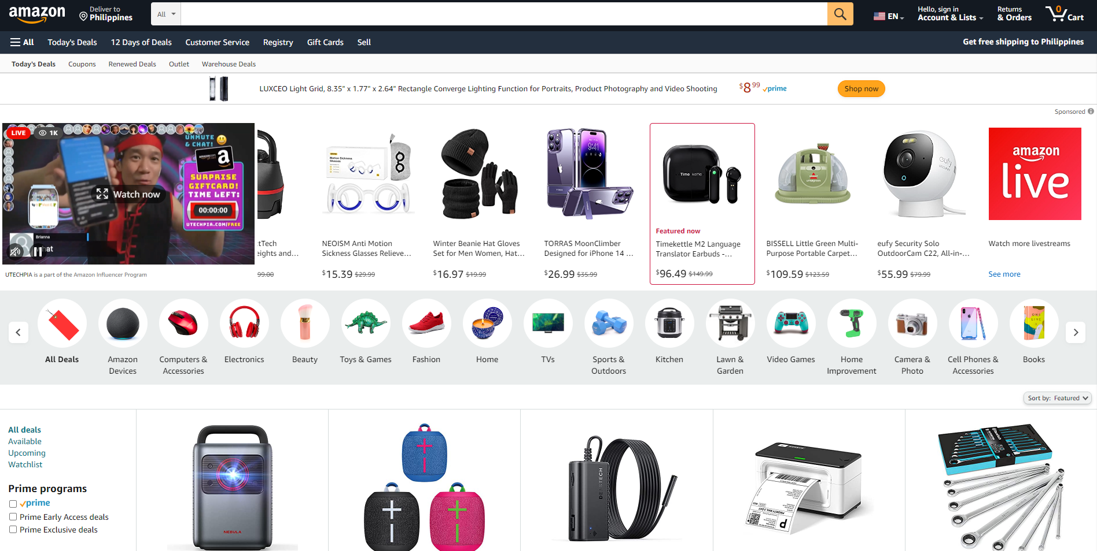
What products are popular during holidays?
What SQL commands would you use to explore this question?

Slide 38
DATA ENGINEERING

Slide 39

Data engineering refers to the building of systems to enable the collection and usage of data. This data is used to enable analysis and data science & machine learning. Making the data usable involves substantial compute, storage, data processing and cleaning.

Slide 40
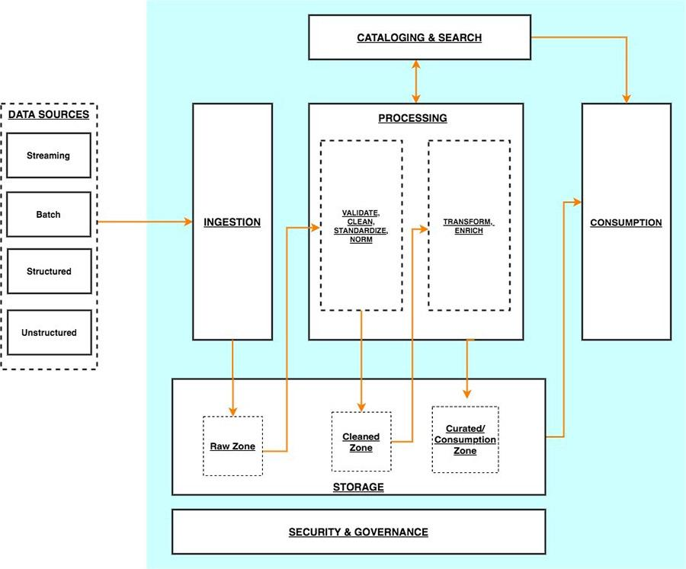
DATA ENGINEERING
Data pipelines are software systems that automate key parts of the data management process.
https://www.equalexperts.com/blog/our-thinking/what-is-a-data-pipeline/
Notes:
You’ll see pipelines are a lot in your career. You might even design one yourselves.

Slide 41
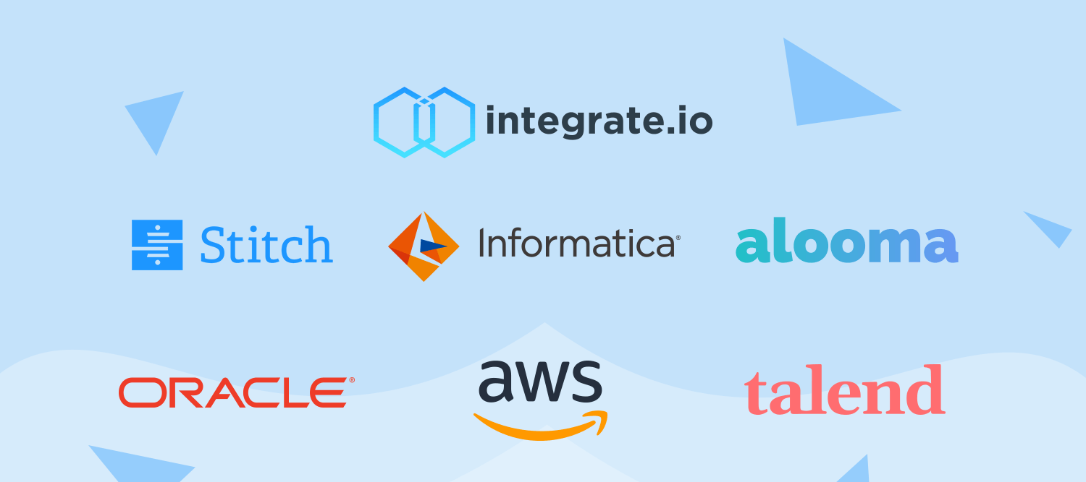
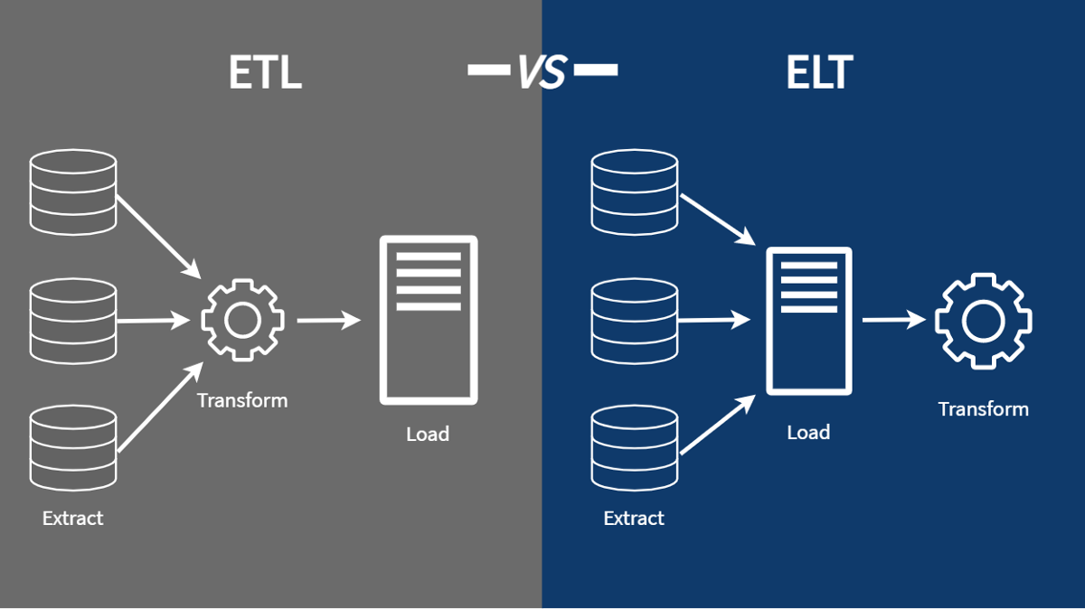
DATA ENGINEERING
In computing, extract, transform, load is a three-phase process where data is extracted, transformed and loaded into an output data container.
https://www.equalexperts.com/blog/our-thinking/what-is-a-data-pipeline/
Notes:
You’ll see pipelines are a lot in your career. You might even design one yourselves.

Slide 42
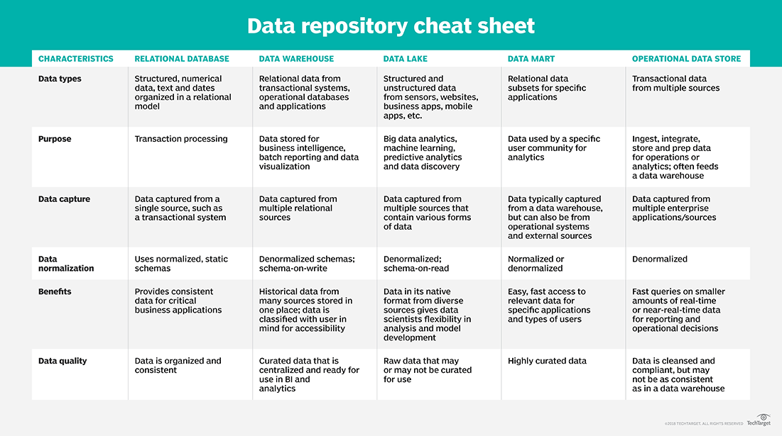
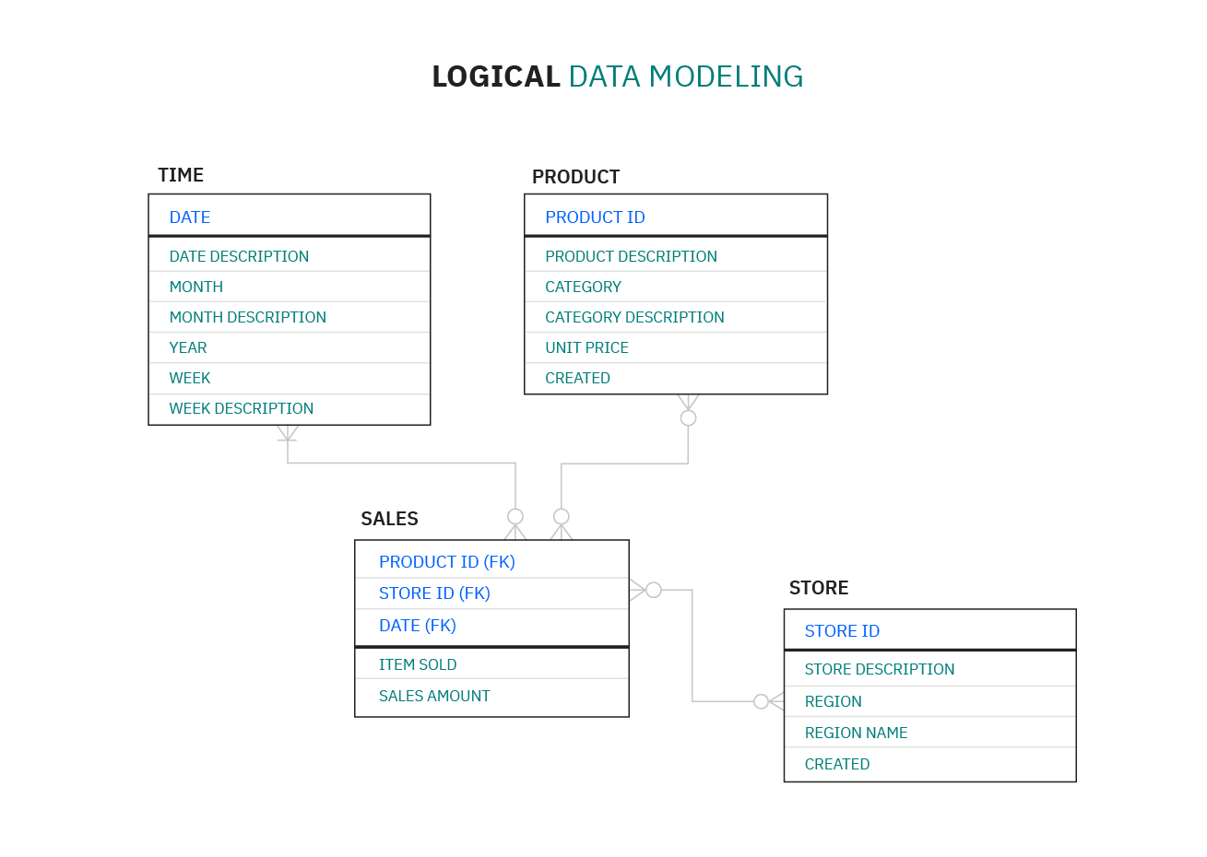
DATA ENGINEERING
https://www.techtarget.com/searchdatamanagement/definition/data-mart
Notes:
You’ll see pipelines are a lot in your career. You might even design one yourselves.

Slide 43
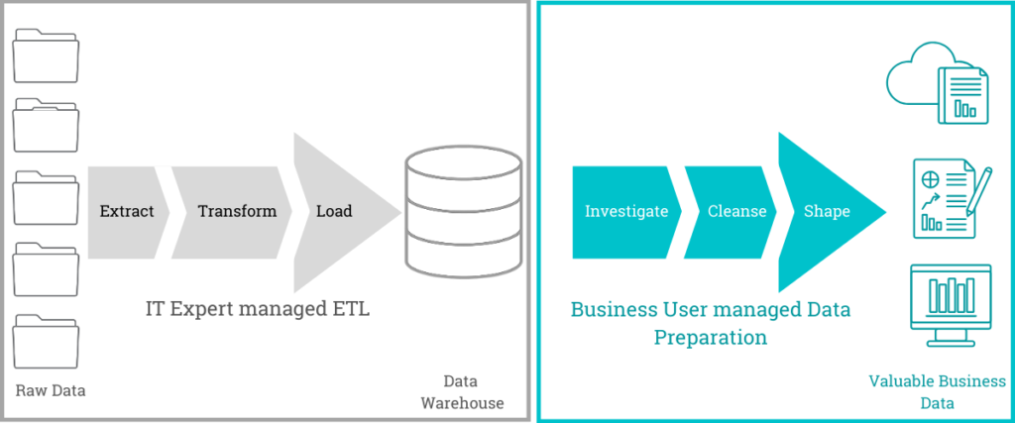
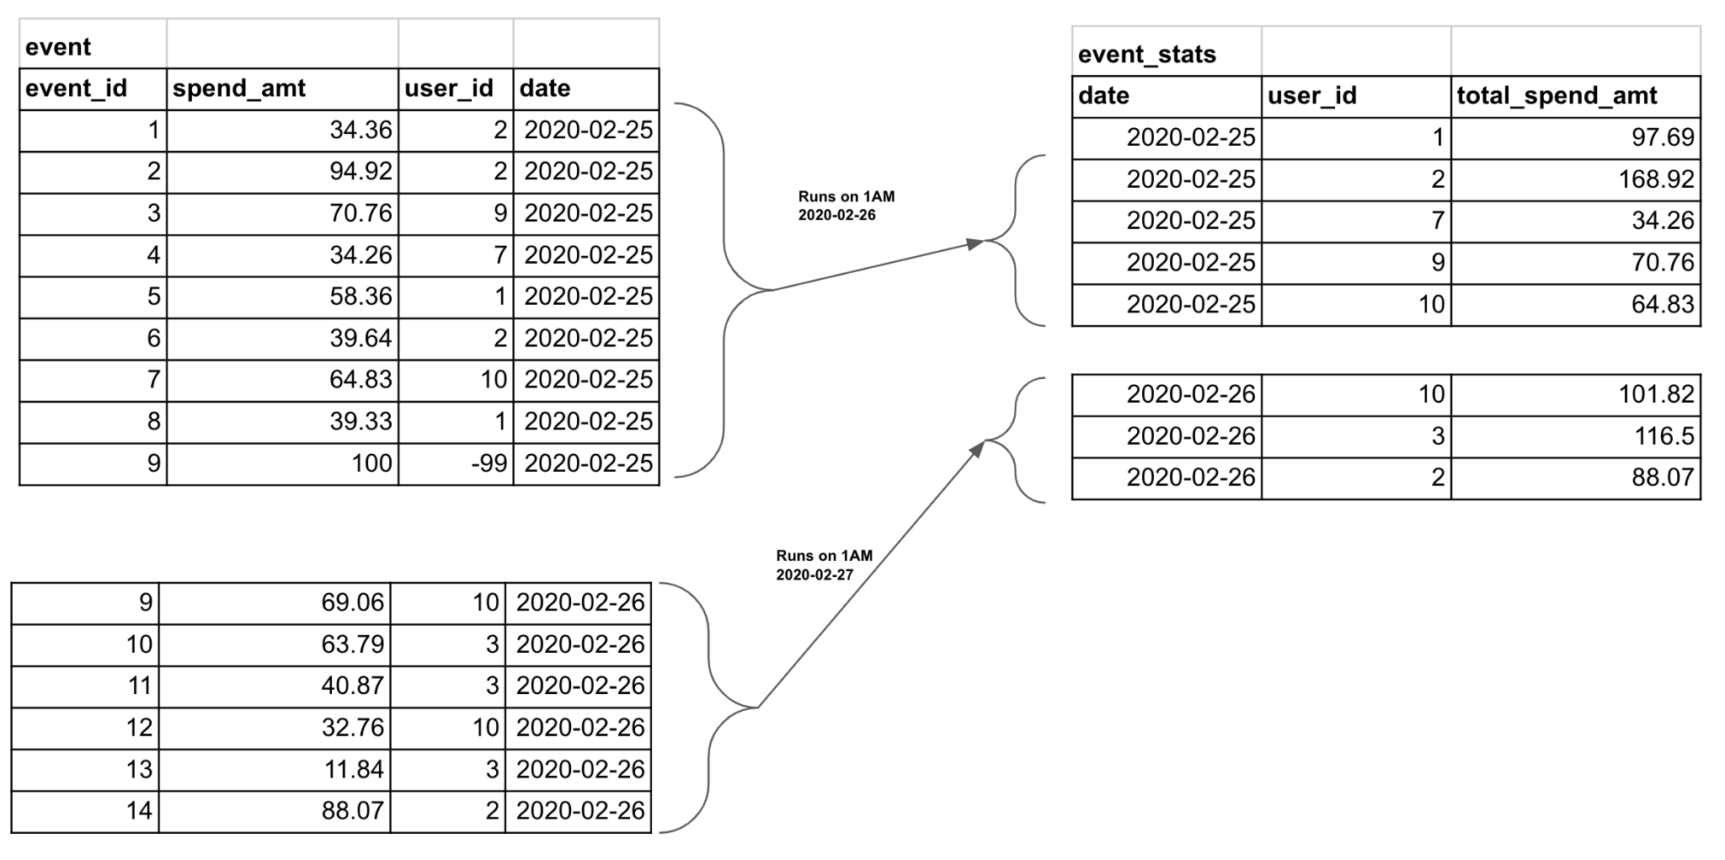
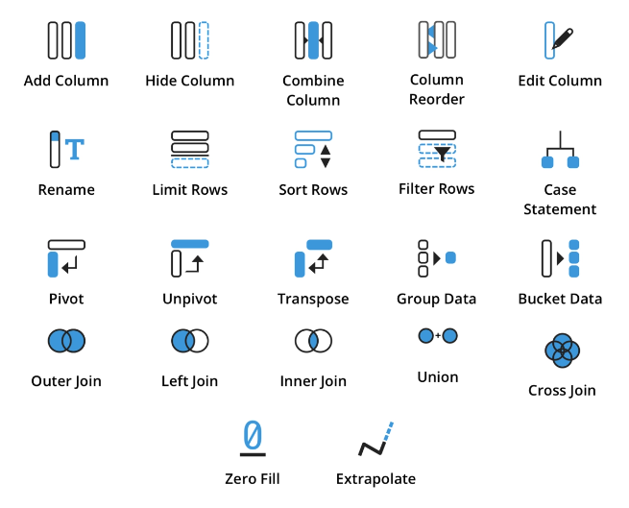
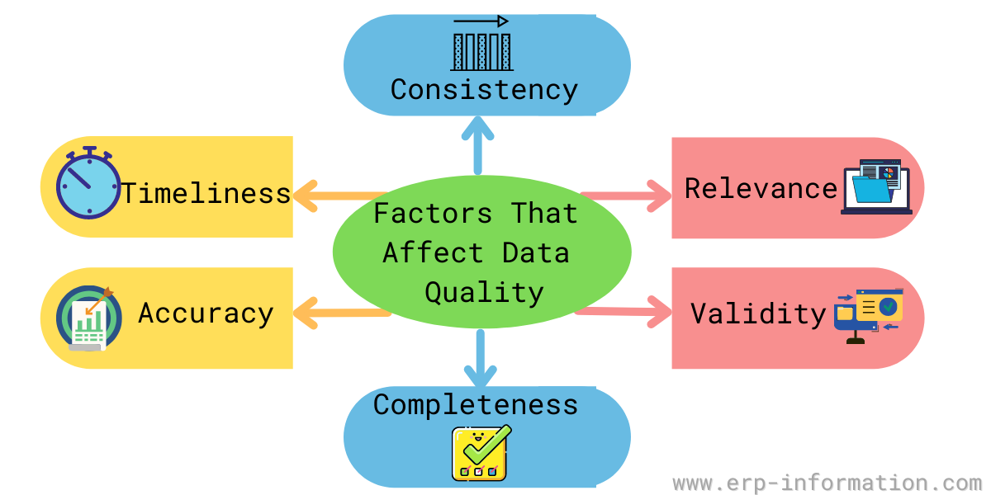
DATA ENGINEERING
Closer to Source
Closer to Use
https://makemeanalyst.com/who-is-big-data-engineer-and-how-to-become-a-big-data-engineer/

Slide 44
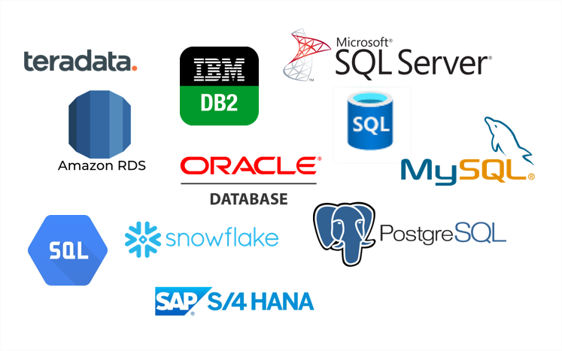
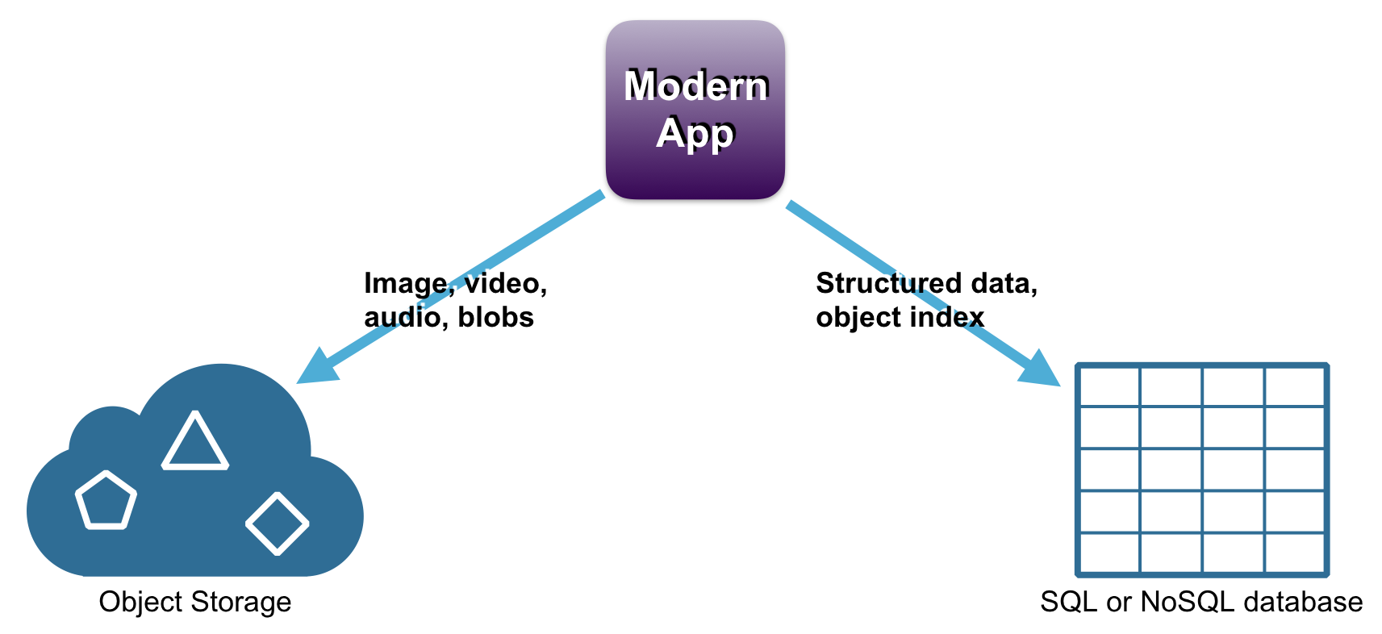
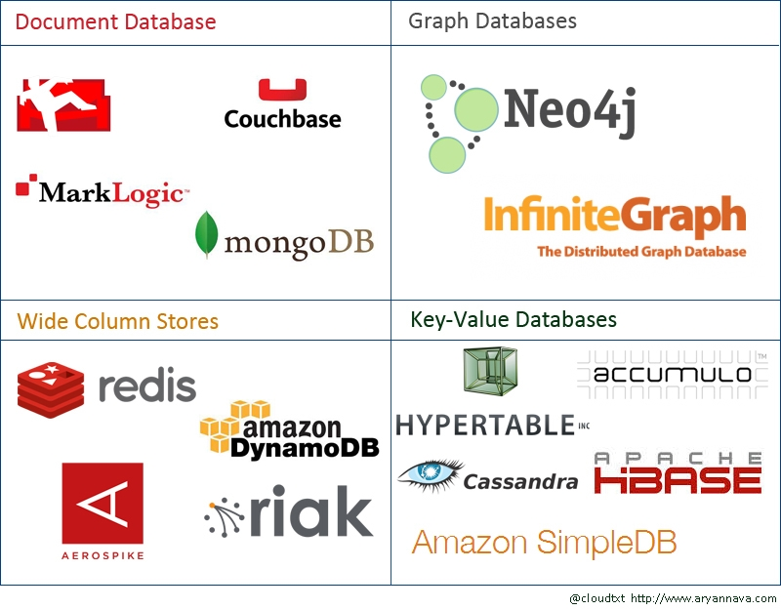
Relational databases are well-structured and tabular in nature
DATA ENGINEERING
NoSQL databases have specialized structures
No matter the type of database, SQL is used or a mindset very similar to it.

Slide 45
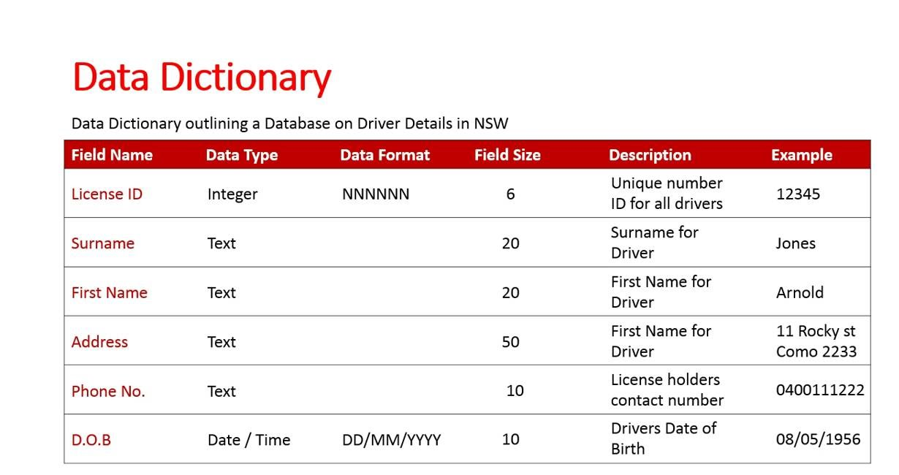
DATA ENGINEERING
Ensure your organization has a data dictionary, updated regularly and with sufficient information.
https://www.youtube.com/watch?v=kH0bcw9P2Lc&ab_channel=ChristopherKalodikis
Notes:
I’ve had an opportunity to jumpstart a data governance practice in a previous role. A data dictionary is one of the first artifacts. Others are the KPIs, regular checks, and communication protocols.
Allow for co-teacher to elaborate:
Back in day 1, there’s a slide on “No reliable info, no insighting.” How can a data dictionary support a project, in daily work?

Slide 46
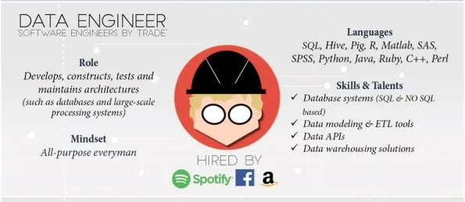
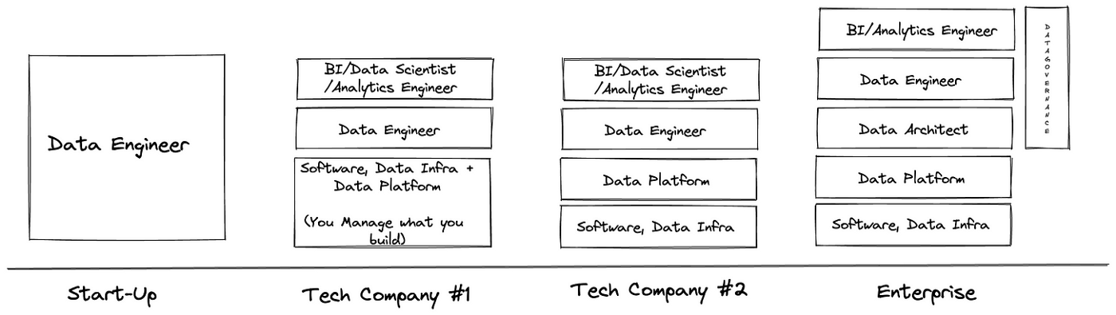
DATA ENGINEERING
Talk to the data engineers when automating the collection and storage part of your project.
https://makemeanalyst.com/who-is-big-data-engineer-and-how-to-become-a-big-data-engineer/

Slide 47
GROUP WORK
Defining data requirements for your analytics project
Choose one domain that you can relate to the most among the following, and define a Business Problem to solve:
BPO
Bank
HR
School
eCommerce
2. List what data are needed to solve the BP. State where they be found.
3. Highlight potential problems/ challenges to these data? Ie. cleanliness, data privacy, formatting, nulls
4. What treatments do you think should be done to the data to make it more usable ie. transformation/aggregation/cleansing/preparation
BONUS: Write an example of how an SQL statement may look like that will help find potential answers to the problem.
Each group to present their results in a 1-slide deck
15 minutes prep, 5 minute presentation

Slide 48
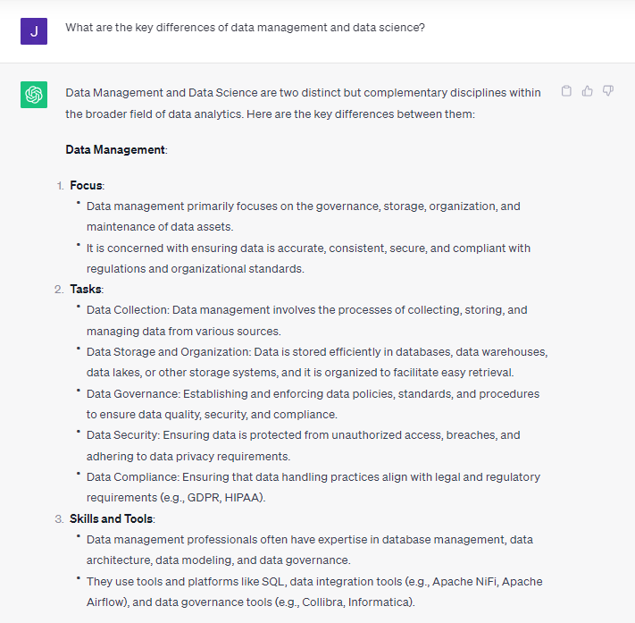
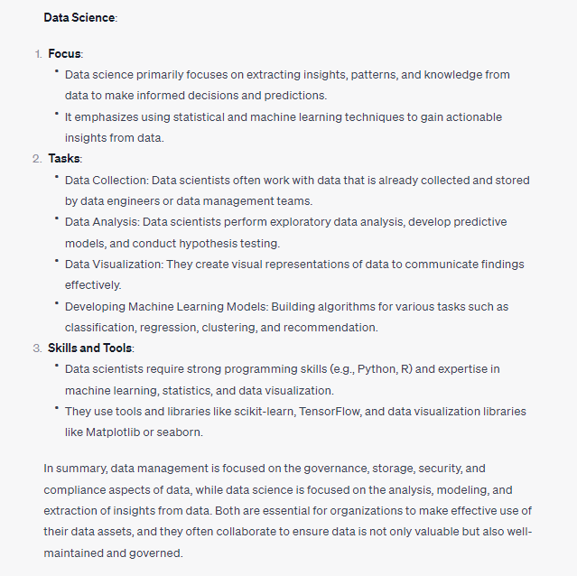
Explaining Concepts
Using ChatGPT

Slide 49
Afternoon
https://github.com/ogbinar/python101/blob/master/notebooks/10_file_io.ipynb
https://github.com/ogbinar/python101/blob/master/notebooks/14_advanced_io.ipynb
Download
https://sqlitebrowser.org/ (64-bit, zip, no installer)
https://github.com/jpwhite3/northwind-SQLite3 (northwind.db)

Slide 50
3 minute presentation
Section | Description | Questions to Answer
Introduction | Brief team introduction and project objective.
Innovation in SQL/Pandas | Highlight the innovative approach used. | "How does your approach differ from more conventional methods?"
Data Analysis | Share a key insight or finding from your analysis. | "What additional checks or analyses did you perform that added value?"
Data Visualization | Showcase your most impactful visualization. | "How does this visualization aid in understanding your findings?"
Team Collaboration | Describe effective teamwork and collaboration. | "Can you share an example of how teamwork helped overcome a challenge?"
Conclusion | Summarize the unique value or key learning.
Notes:
Introduction and Setup (10 minutes)
Welcome the participants and give a brief overview of the hackathon's objectives and format.
Quickly walk through the basic use of SQL and Pandas as they'll need these for the exercises.
Ensure everyone has access to the tools and databases required (SQL environment and Python setup).
Team Formation and Challenge Kick-off (5 minutes)
Divide participants into five teams, aiming for mixed skill levels in each to foster peer learning.
Present the list of SQL queries they will be working on, focusing on the practical aspects of interacting with the Northwind database.
Rapid Hackathon Session (60 minutes)
First 30 minutes: Teams work on the first five questions, which cover basic SQL queries and introductory data manipulation using Pandas.
Next 30 minutes: Teams that quickly complete the first set can move on to the more challenging bonus questions. This optional part aims to stretch their abilities and introduce more complex SQL features.
Mentors roam between teams to offer hints and ensure all participants are actively engaged.
Team Presentations and Review (10 minutes)
Allow each team about 2 minutes to share their most interesting query or insight from the session. This promotes a sense of achievement and allows sharing of knowledge.
Provide immediate feedback from a panel of experienced judges or mentors, focusing on creativity, accuracy, and learning.
Closing (5 minutes)
Quickly wrap up by recognizing all teams for their participation, with special mention of any outstanding performance or creative solutions.

Slide 52
DATA MANAGEMENT
Location
Local
On prem Server
Cloud
Format
Flat Files ie. CSV, Excel
Binary
Database
Retention
How long do we keep it?
How much do we keep?
How recent are refreshes?
Security
Who can access the data?
Is the data encrypted?
Do we backup?

Slide 53
DATA DEMOCRATIZATION

Slide 54
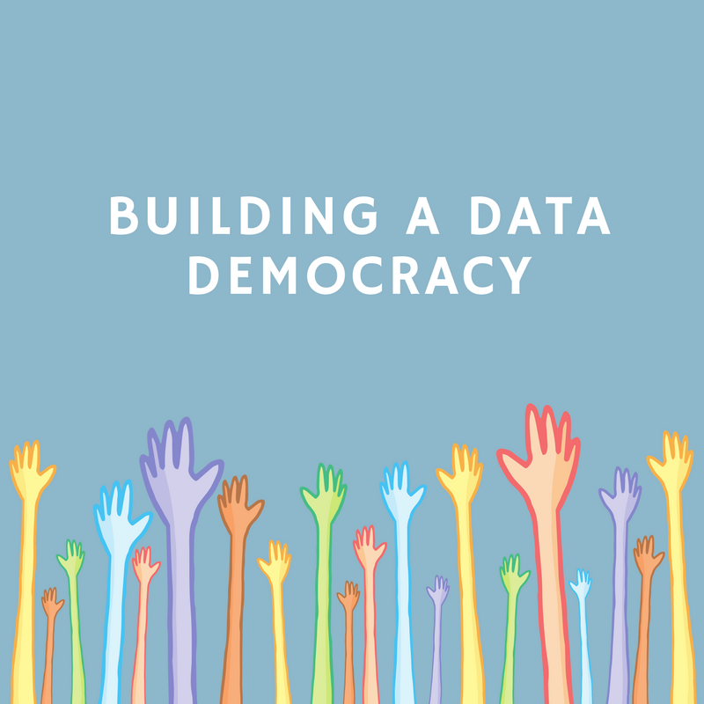
Data democratization is when an organization makes data accessible to all employees and stakeholders, and educates them on how to work with data, regardless of their technical background.

Slide 55
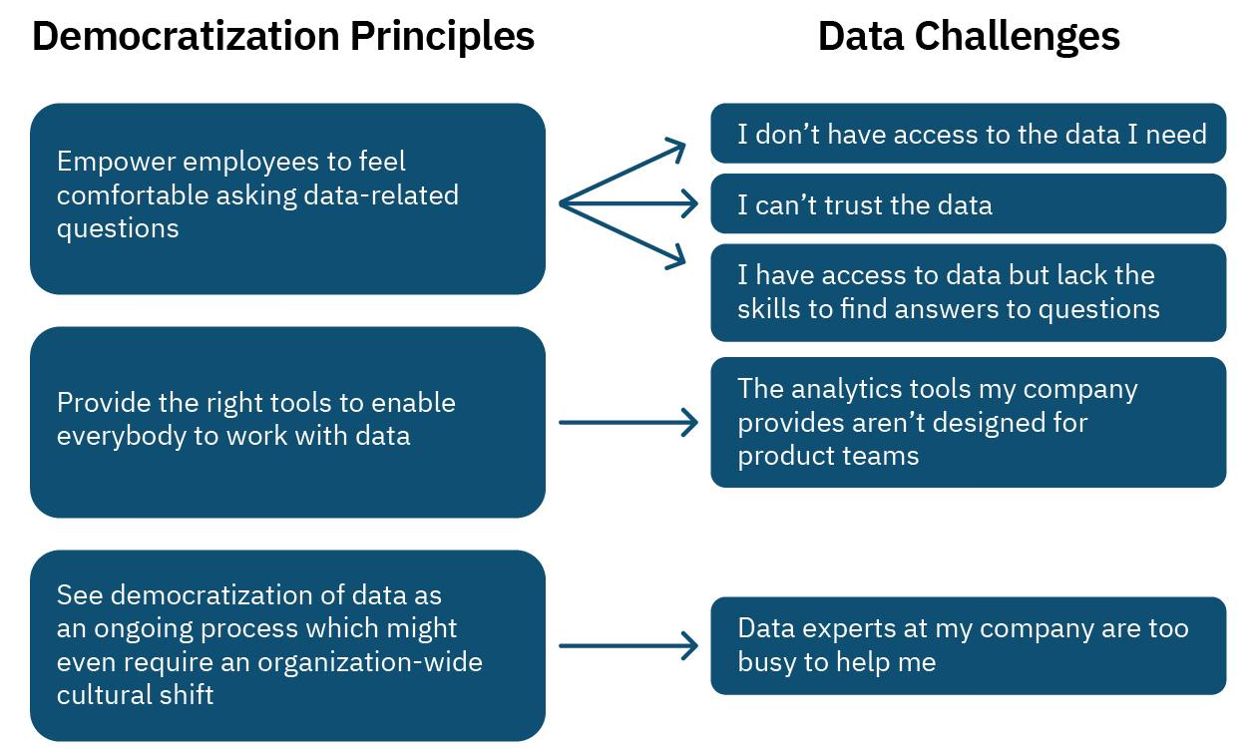
WHY IS DEMOCRATIZATION IMPORTANT?

Slide 56
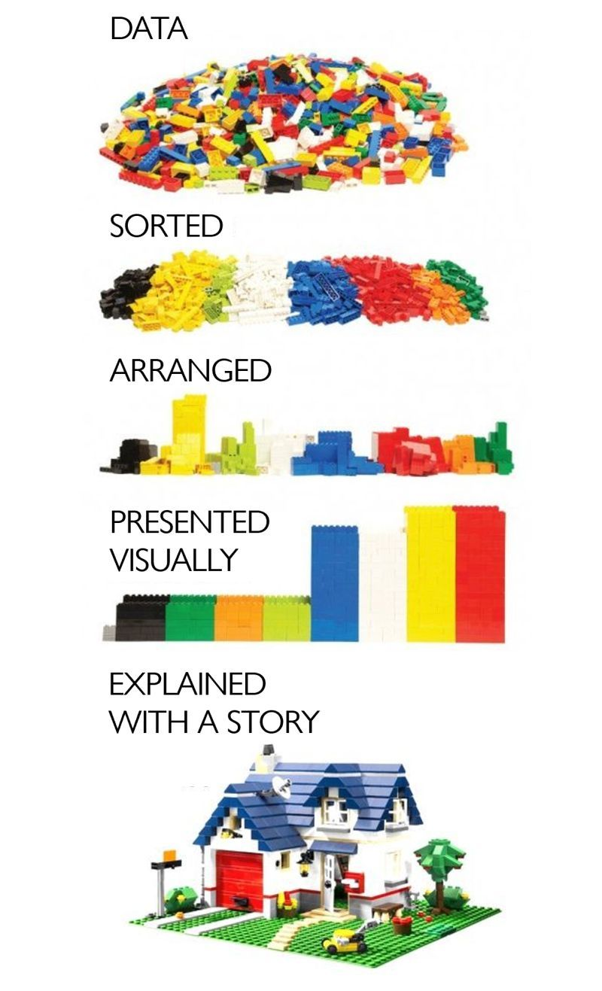
DATA 101
Data vs Information vs Knowledge
Data
Raw facts
No context
just numbers, text, images, videos, etc.
Information
Data with context
Processed data
Value added to data
Summarized
Organized
Analyzed
Graphed / Visualized
Described
Knowledge
How is this information tied to outcomes?
Are there any patterns in the information?
What information is relevant to the problem?
How does this information affect the system?
What is the best way to use the information?
How can we add more value to the information?
Data Increases in Value →

Slide 57
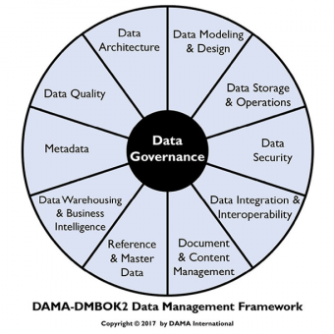
MILESTONES: Governance
It is a framework of processes, policies, metrics, and stakeholders that manage the organization’s data assets.
https://tdan.com/the-data-centric-revolution-semantics-and-the-dama-wheel/25576

Slide 58
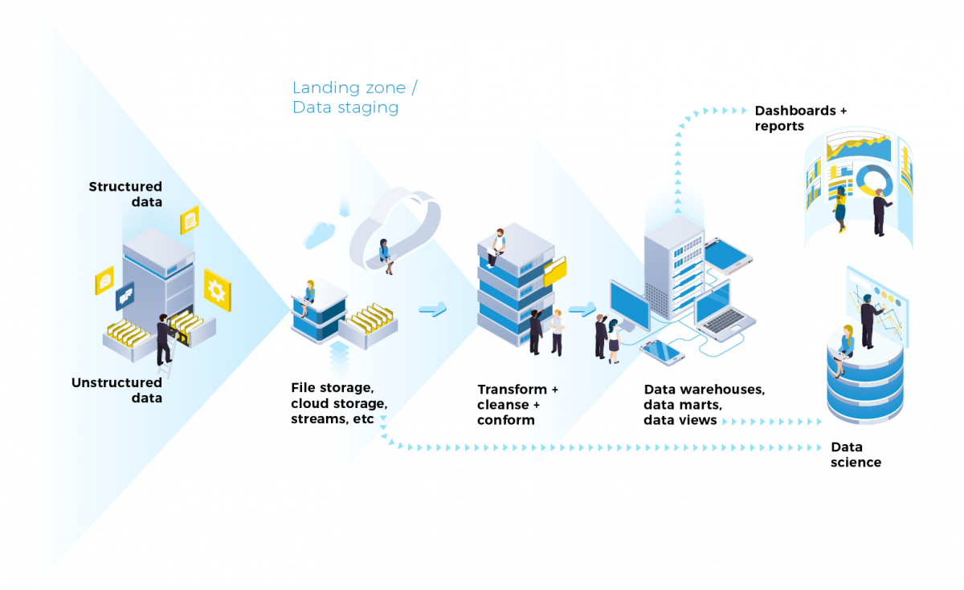
DATA ENGINEERING
Data pipelines are software systems that automates key parts of the data management process.
https://www.equalexperts.com/blog/our-thinking/what-is-a-data-pipeline/
Notes:
You’ll see pipelines are a lot in your career. You might even design one yourselves.

Slide 59
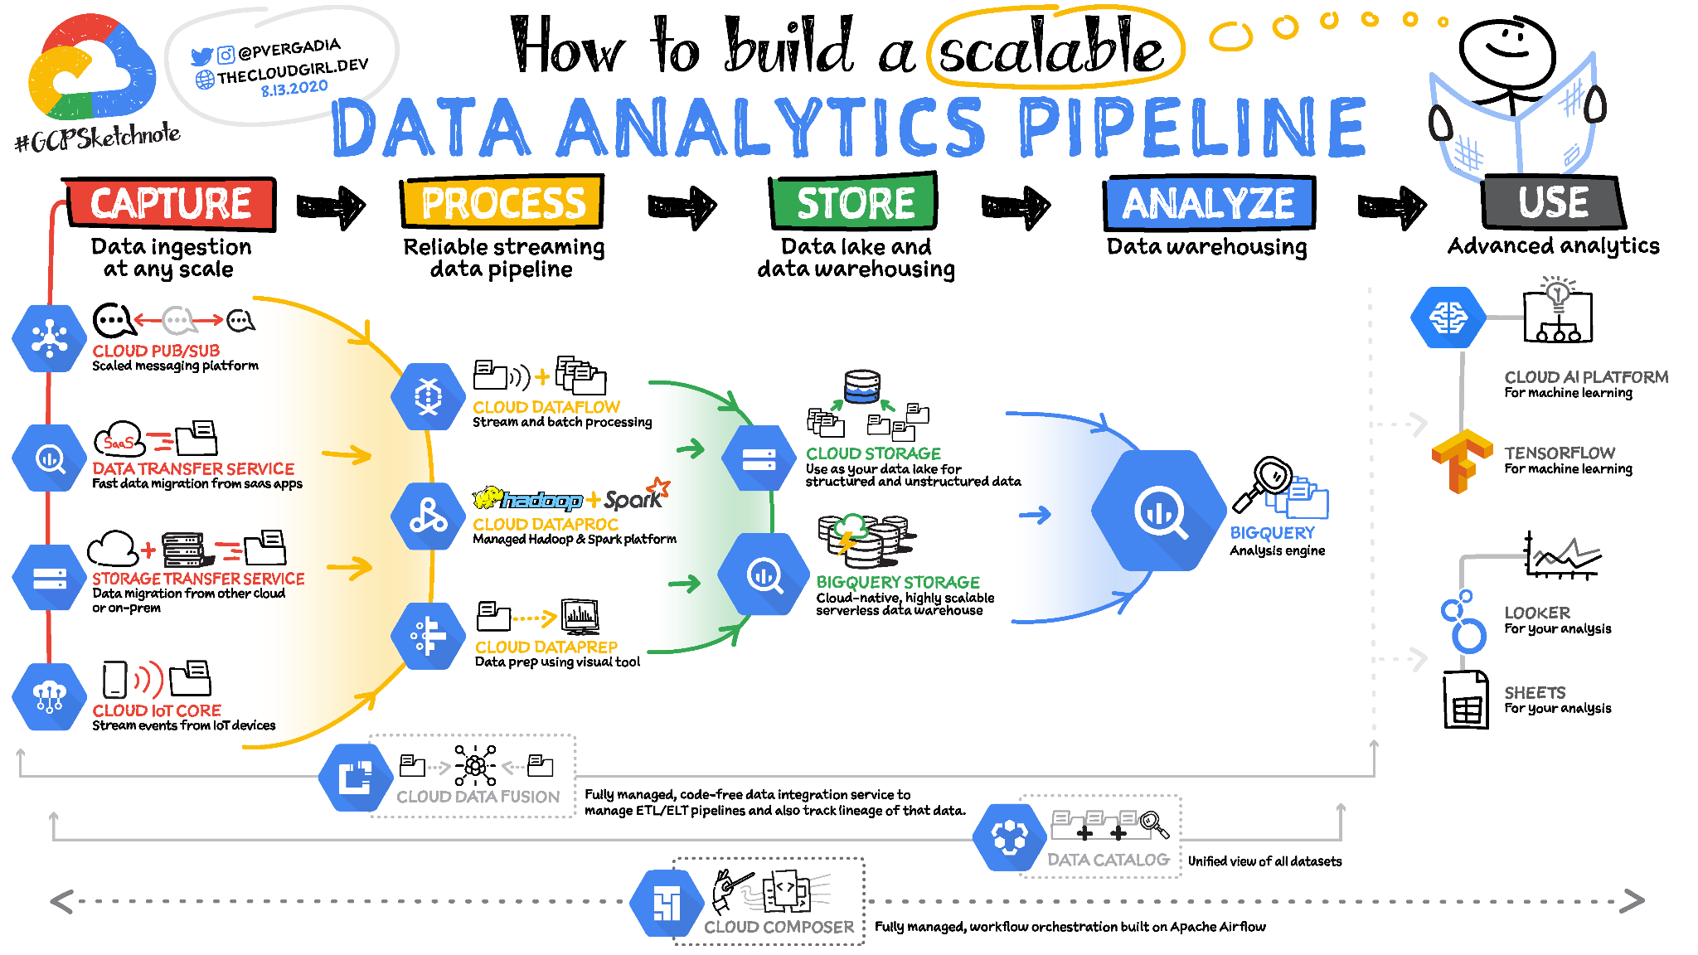
Collection (advanced)
Whole careers are built in the collection - storage phase.
Always be in sync with your data engineers.
https://www.freecodecamp.org/news/scalable-data-analytics-pipeline/

Slide 60
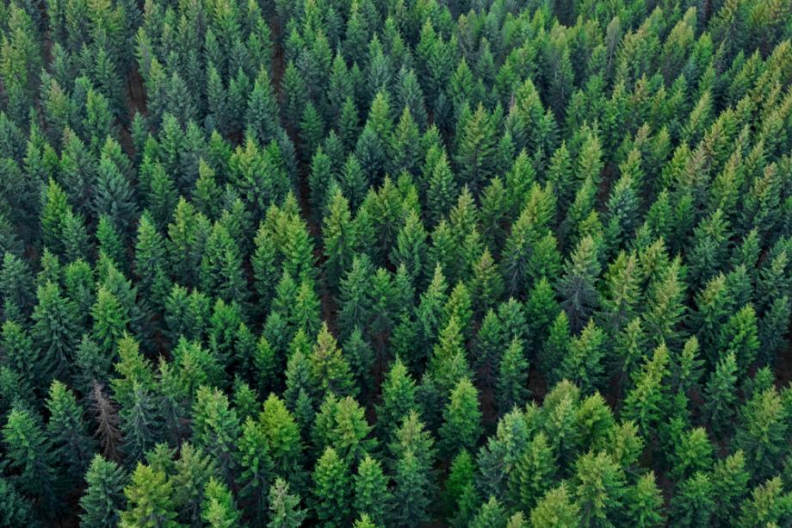
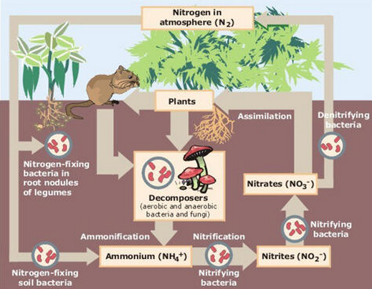

INTRODUCTION
DATA AS AN ARTIFACT
DATA AS A JOURNEY
DATA MANAGEMENT MILESTONES
Notes:
Nature metaphors – so data doesn’t sound too artificial, impersonal, or unnatural :)
Artifact - large forests, amazing and daunting
Journey - intricate systems to generate and use it
Milestones - Stop and smell the flowers

Slide 61
Data as an Artifact
A forest of trees is a spectacle too much for one man to see.

Slide 62

DATA AS AN ARTIFACT
Data is a precious thing and will last longer than the systems themselves.
Tim Berners-Lee, an inventor of the WWW

Slide 63

Data Management
Data or Metadata?
Metadata is DATA that DESCRIBES another DATA
Example:
FTW is FUN!
Data without metadata can potentially be worthless ☹

Slide 64
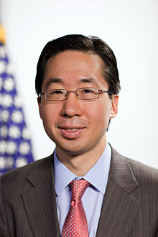
DATA AS AN ARTIFACT
Data by itself is useless. Data is only useful if you apply it.
Todd Park, former CTO of the USA

Slide 65
Data as a Journey
I took a walk in the woods and came out taller than the trees.

Slide 66
DATA AS A JOURNEY
Data is transformative
A mess of pieces can shape an organization’s future
A data strategy is vital
Repeated and agile = Win
A data-driven culture is key, from collection to use
https://www.linkedin.com/posts/andreasvonderheydt_the-difference-between-raw-data-and-the-stories-activity-6837751869125873664-beki/
Notes:
Great graphic
That data is transformative, also requires data to be transformed

Slide 67
DATA AS A JOURNEY
Just in the last work week, which part of the hierarchy were you working on?
https://hackernoon.com/the-ai-hierarchy-of-needs-18f111fcc007
Notes:
Allow for co-teacher to elaborate:
Also answer the question, which part of the hierarchy have you been working on
The AI, ML, DL hype

Slide 68
DATA AS A JOURNEY
The Data Lifecycle
Generation / Collection
Data is “born” and need to be collected and stored
Use
Processed data / information / knowledge is accessed by end user applications
Cleansing / Preparation
Once gathered, data needs to be “prepared” for use
Analysis / Processing
Data is transformed for use towards specific business problems
Sharing
Data is shared to users for reporting, analysis, or further collection

Slide 69
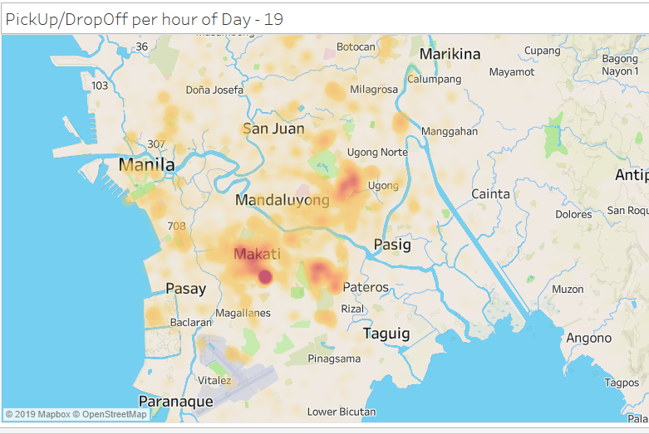
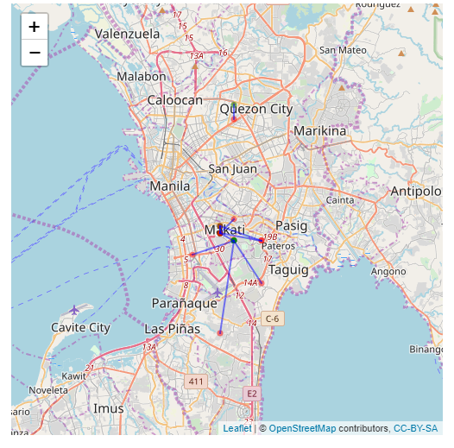
Where are the usual trips of Grab drivers?
What SQL commands would you use for this?

Slide 70
ACTIVITY
For each of the SQL statements on the right, think of a business question or objective that it addresses.
Use any of the following verticals. You may choose differently for each statement.
national healthcare system
ridesharing app
toy manufacturer
online course provider
Describe your thoughts to the group through a doc / sheet / slide
An actual SQL query is not necessary.
20 minutes prep & 15 minutes sharing
Select, between
Select count, where, order by
Select sum, group by, having
Left Join / Inner join
Union
A query that needs a subquery
Notes:
Business questions!

Slide 71
Data Management Milestones
Stop and smell the flowers

Slide 72
Data Management comprises all disciplines related to managing data as a valuable resource.

Slide 73





Data as it grows in value
A Data Management Metaphor
Collection
Storage
Quality
Governance
Consumption
From "How Do Apples Grow" by Jill McDonald
Notes:
Collection - just raw potential.
Storage - you’re starting to see roots and a sturdy trunk, but it’s still useless.
Quality - it looks beautiful and there’s already some value here
Governance - now we have fruit-bearing trees and we take care of it
Consumption - delivery!
And every time we have a new project, we just revisit our trees

Slide 74
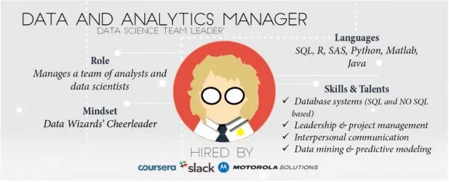
MILESTONES: Value
Where is the value?
Are the outcomes valuable?
Is the project feasible?
Skills, technologies, executive support
What data is needed?
Failure is likely if the value is vague, the data is non-existent, and the feasibility is artificial.
https://makemeanalyst.com/how-to-become-a-data-manager-how-to-get-into-data-manager-job-role/

Slide 75
MILESTONES: Collection
If the data exists, where is it generated / captured so we can collect them?
Traditional
Observations
Tests
Surveys
Documents
Corporate
Point of Sale
Inventory Systems
HR systems
Internet Proxy
Edge Sensors
Weather balloons
ID scanners
CCTV cameras
Home internet routers
BONUS: External Data
Government Websites
Yellow Pages
Twitter
Data sellers ie. Nielsen
Notes:
Allow for co-teacher to elaborate. What are the most unique data points you have encountered? (free of NDA, :D)

Slide 76
MILESTONES: Quality
Clean data is usable data
Take the example of an online bookstore:
Duplicate transactions
Misspelled authors
Outdated promo codes
Missing publication year
CSRs type different date formats in shipping returns
Comment fields contain social security #s
Purchase date happened after shipping date
What queries would you do for these?

Slide 77
Quality (advanced)
Implementing business rules is a key part of quality
Example: Summing up sales figures for audit and reporting
For accuracy, the correct joins need to be defined
Item
price
Bundle
price
Transaction
amount
Promo
rate
Returns
How?
SalesSummary

Slide 78
MILESTONES: Consumption
How do we share the data so people can use it?
Centralized Internal Database
Secure API over Internet
Restricted network drives
Password protected files
Business Intelligence / Reporting
Dashboards
Archiving
Legal

Slide 79
MILESTONES: Consumption
Can the data do more?
This is where YOU come in!
What tools can we use on the data? Ie. R, Python, SAS, Java, Tableau, PowerBI, etc.
What new insights / knowledge can be generated?
Can your discoveries address business problems and generate value?
Notes:
Speaking of data scientists, let’s segue to the roles in the data science world and where YOU can come in.

Slide 80





Roles (advanced)
Data Science is a Team Sport
Data scientists are now specializing in different dimensions.
Data Engineer
I collect, generate, and maintain the mountain of data.
Data Analyst
I find valuable minerals in the data. And share this on the daily!
Statistician
I determine which of the minerals are gold, and how best we can productize it.
ML Engineer
I create a way to develop and distribute the golden products efficiently.
Recommended Reading:
https://towardsdatascience.com/data-sciences-most-misunderstood-hero-2705da366f40

Slide 81
Roles (advanced)
Data Science is a Team Sport
Data scientists are now specializing in different dimensions.
Data Engineer
Manages the data so the organization can utilize its full potential
Favored tool: Databases
Data Analyst
Quickly identifies value worth pulling the rest of the crowd for
Favored tool: Data viz
Statistician
Creates the best certainties in a palette of uncertainties
Favored tool: Inferential stat
ML Engineer
Manages, deploys, and sustains models in production
Favored tool:
Good code

Slide 82
MILESTONES: Summary
Data should continuously generate value.
Strive for a sustainable data culture
Collection
Storage
Quality
Governance
Consumption
From "How Do Apples Grow" by Jill McDonald

